Slide 1
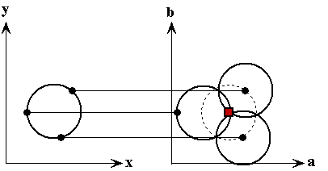

OBJECT TRACKING USING RASPBERRY PI

Slide 2
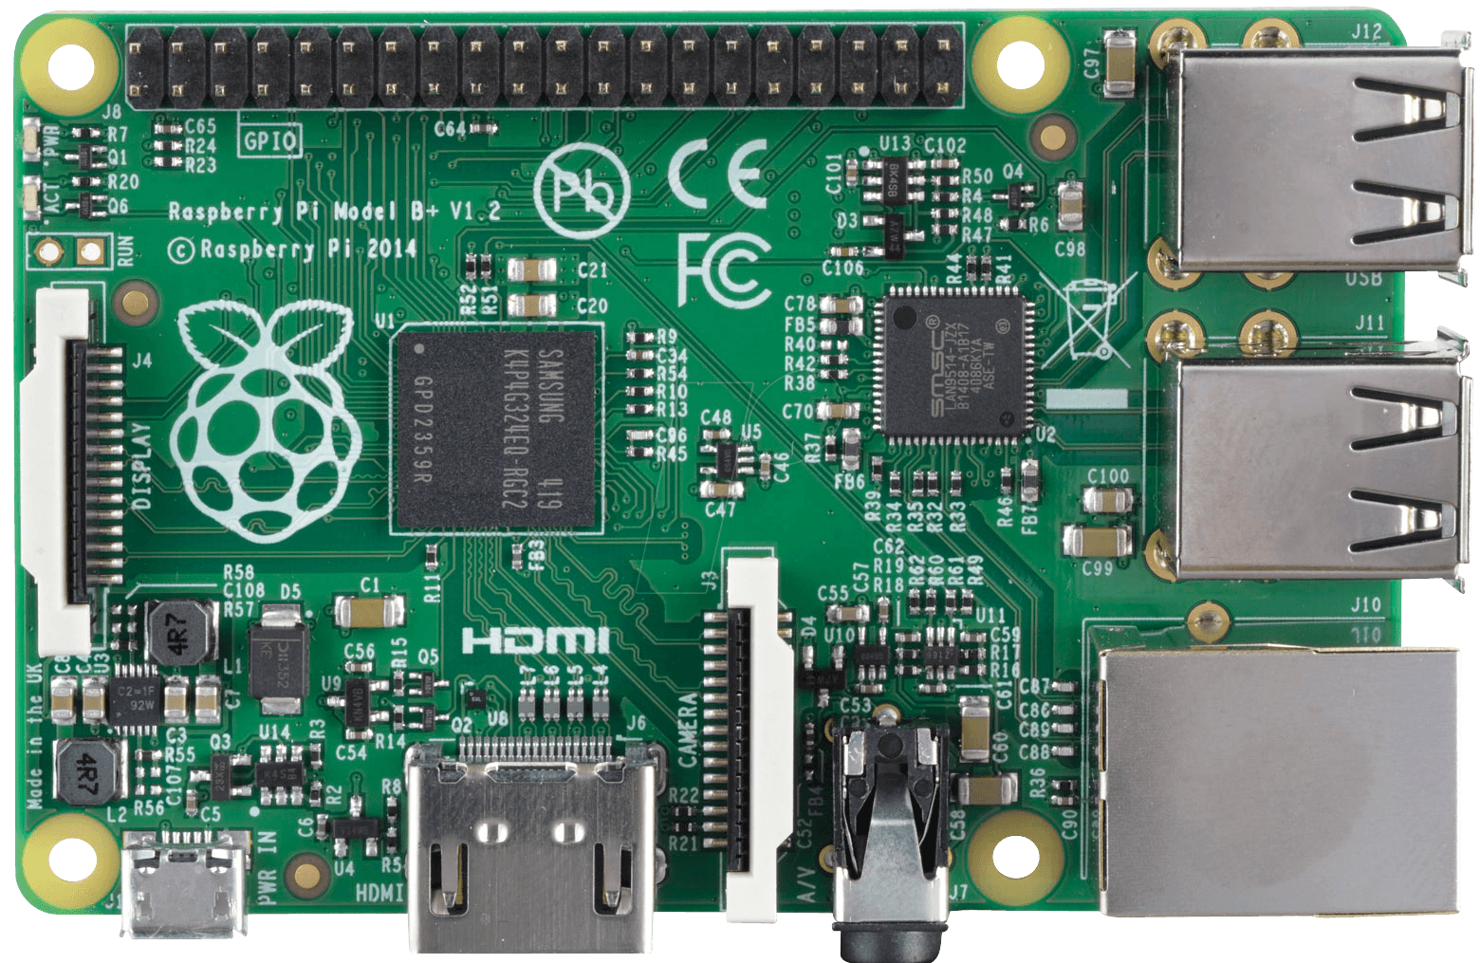
RASPBERRY PI

Slide 3
FEATURES
CPU: Quad-core 64-bit ARM Cortex A53 clocked at 1.2 GHz
Memory: 1GB
USB ports: 4
Video outputs: HDMI, composite video (PAL and NTSC) via
3.5 mm jack
Network: 10/100Mbps Ethernet and 802.11n Wireless LAN
Peripherals: 17 GPIO, and HAT ID bus
Bluetooth: 4.1
Power source: 5 V via MicroUSB or GPIO header
Size: 85.60mm × 56.5mm
Weight: 45g (1.6 oz)

Slide 4
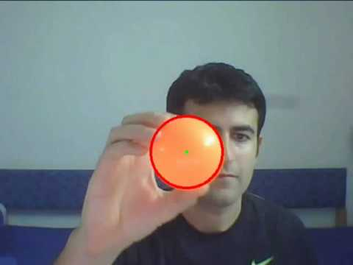
OBJECT TRACKING
Object tracking is the process of locating a moving object
(or multiple objects) over time using a camera.

Slide 5

OPEN CV
Open Source Computer Vision
It’s a library programming function
Aimed at realtime computer vision

Slide 6
CHT
CIRCLE HOUGH TRANSFORM
It’s used in Digital Image Processing for detecting circular objects

Slide 7
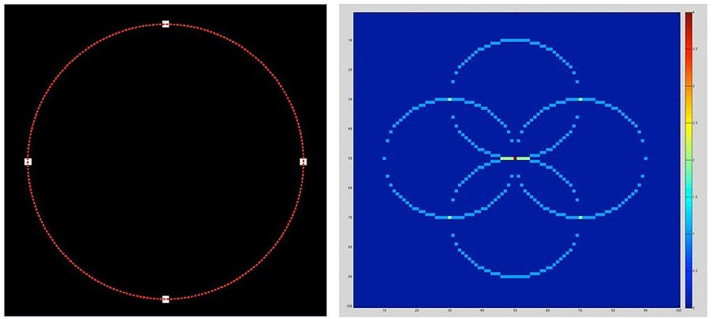
It’s used for finding circles in imperfect image inputs

Slide 8
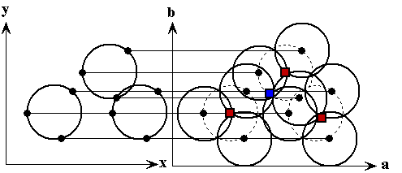
ACCUMULATOR MATRIX METHOD
By use of Voting it increases the intersection
points in a given object

Slide 9
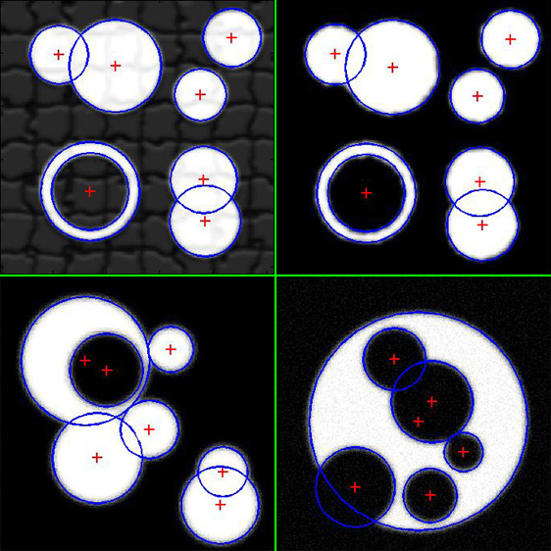
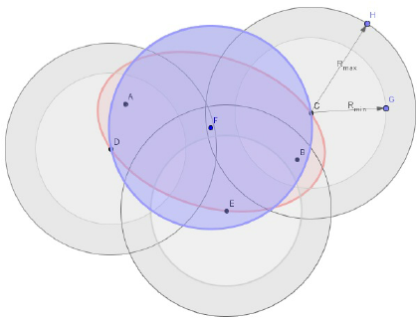
VOTING

Slide 10
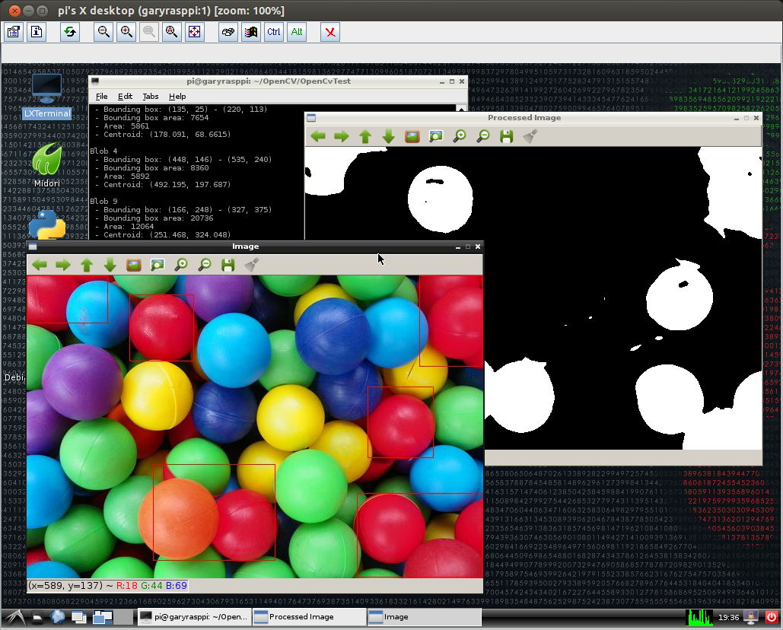
THRESHOLD LEVEL

Slide 11
ALGORITHM
PROCESS THE FILTERTING IMAGE AND CONVERT IT INTO GREY SCALE IMAGE.
FINDING THE EDGES USING “CANNY EDGE DETECTION”.
VOTE ALL POSSIBLE CIRCLES IN ACCUMULATOR.
THE LOCAL MAXIMUM VOTED CIRCLES OF ACCUMULATOR GIVES THE CIRCLE HOUGH SPACE
THE MAXIMUM VOTED CIRCLES IN ACCUMULATOR GIVES THE CIRCLE.

Slide 12
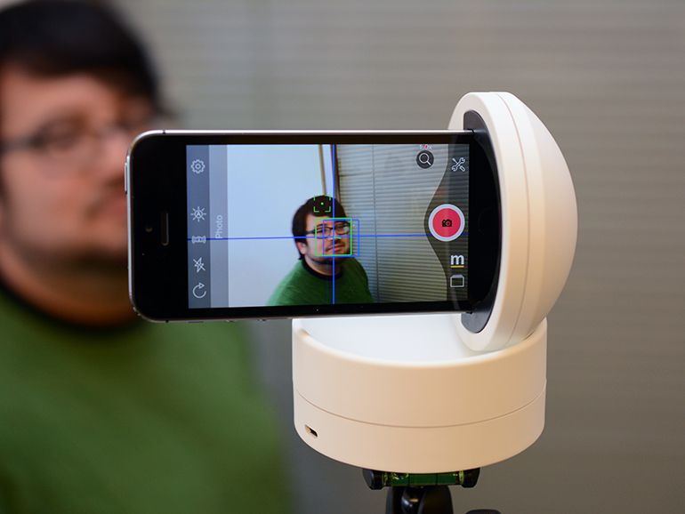
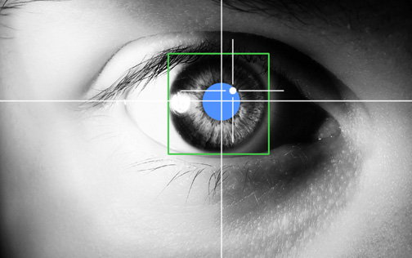
REAL TIME APPLICATION
HUMAN COMPUTER INTERACTION

Slide 13
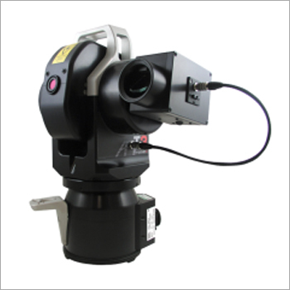
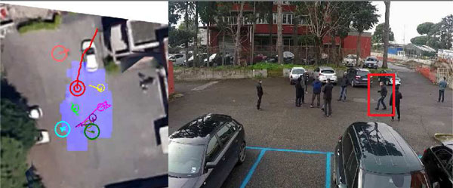
REAL TIME APPLICATION
OBJECT TRACKING IN SURVILLENCE CAMERA

Slide 14
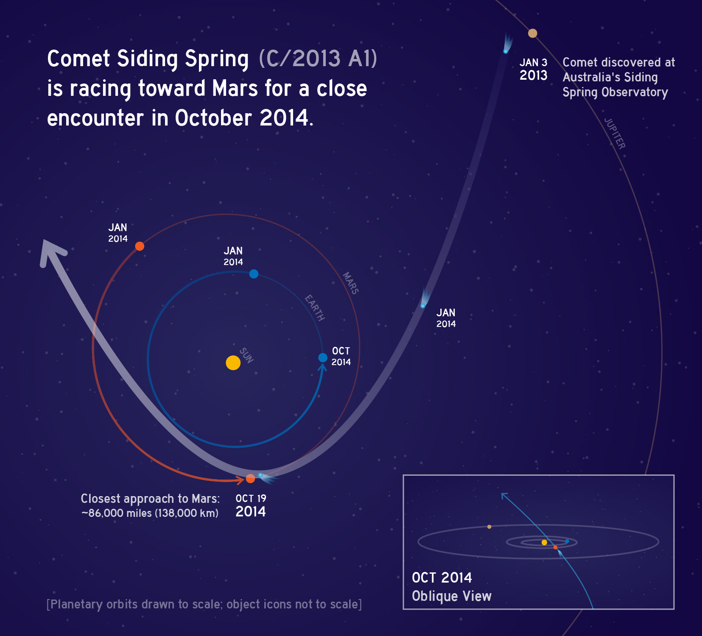
REAL TIME APPLICATION
DETECTING SUSPICIOUS OBJECTS IN SPACE

Slide 15
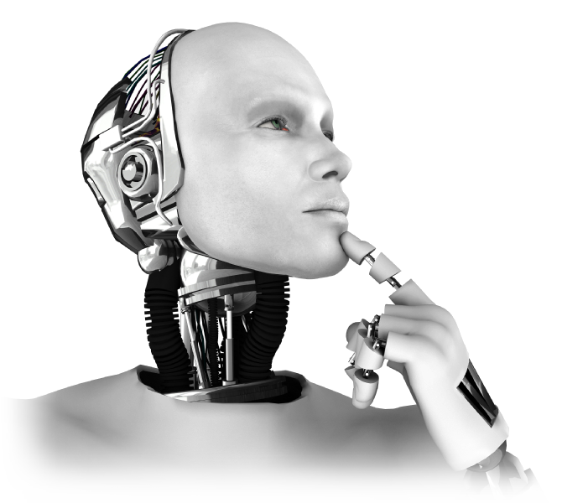
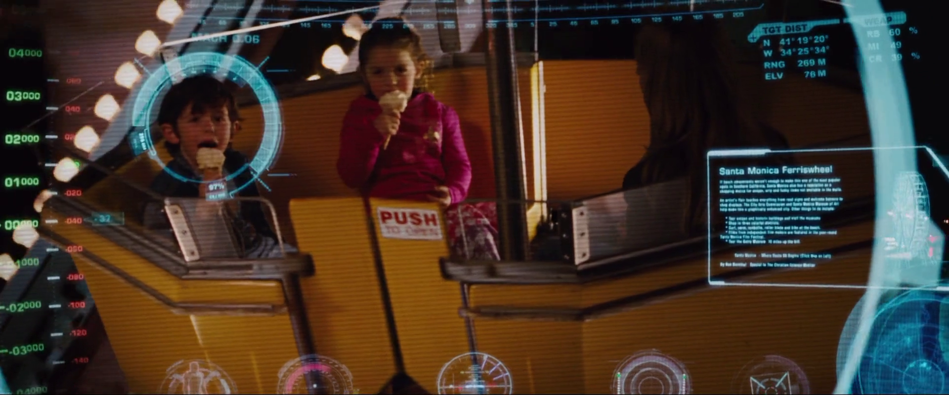
REAL TIME APPLICATION
ARTIFICIAL INTELLIGENCE

Slide 16
THANK
YOU

